Slide 1
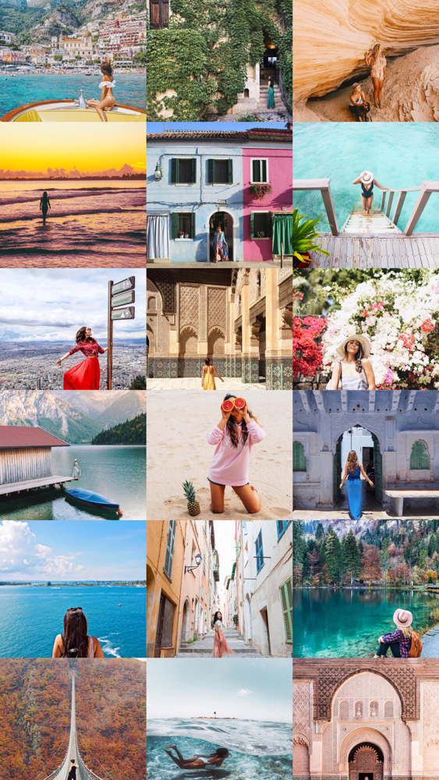
Instagram – Using Computer Vision, Topic Modeling and machine learning to Increase Engagement for ‘Travel’ Content on Instagram
Team
Prathyusha Vedulla
Aishwarya Sarkar
Vivian Wang
Anushka Iyer
Amritangshu Mukherjee
Notes:
Prat

Slide 2
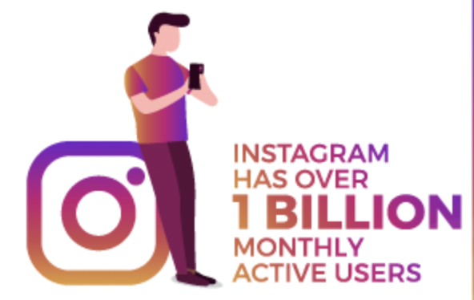


Problem Statement - A Recipe For Instagram Success
Using Computer Vision, Topic Modeling and machine learning to Increase Engagement for ‘Travel’ Content on Instagram
In what ways can machine learning assist in increasing engagement on Instagram?
Exactly what type of picture attracts attention and engagement?
Items in the Image?
More Likes and Comments
Keywords in Captions?
Popular Topics?
Notes:
Prat - Brands want to promote things on Instagram and influencers would like to improve

Slide 3
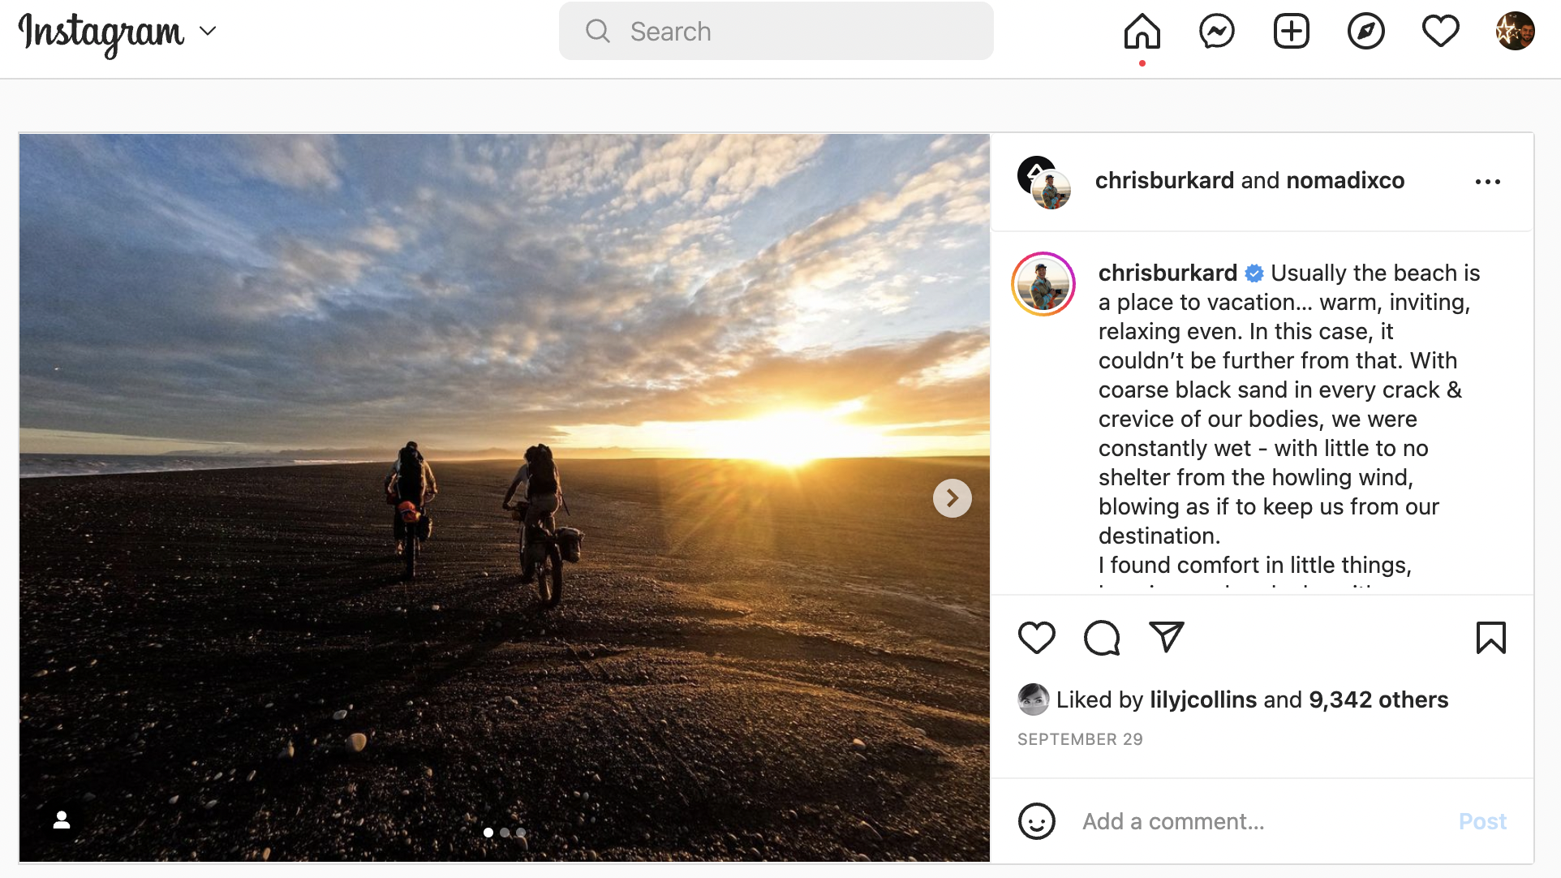
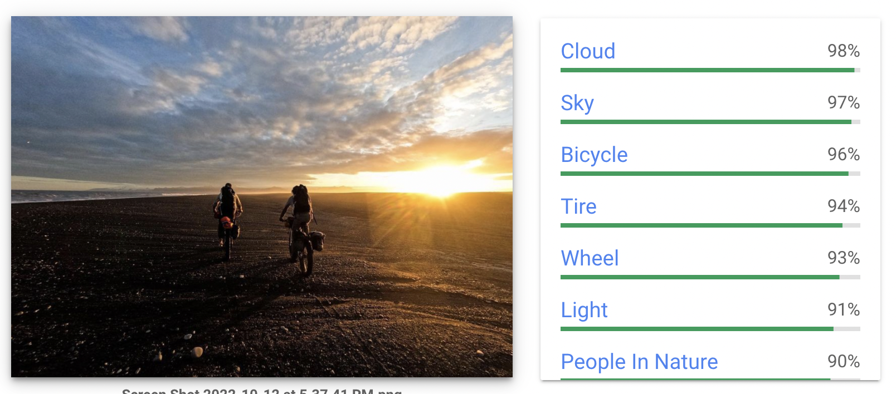


Data Sources
Scrapping using Selenium and Instagram API
-
Generating Image Labels – using Google Vision API
Instagram
Google Vision API
Notes:
Vivian

Slide 4
Methodology
Caption
High/Low/Med
Engagement Rating
Followers
Image, Comments
Scrape Instagram
Image - Google Vision API–Generate Labels
LDA Topic Model – Image Labels
LDA Topic Model - Captions
Linking Topics to engagement
Build Classification Model for Engagement
Build Model to get engagement Classification
Spacy Similarity, Word Frequency and Sentiment Analysis
LIFT Values to determine association with content type
Image Captions
Notes:
Vivian

Slide 5
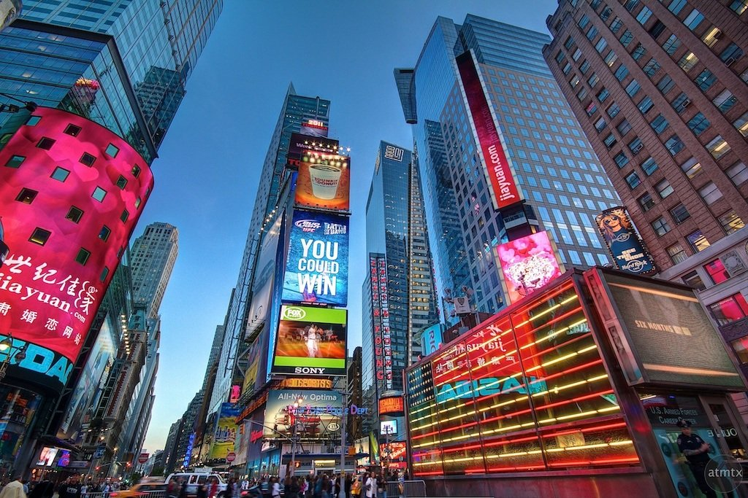
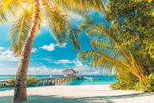
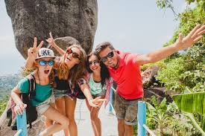
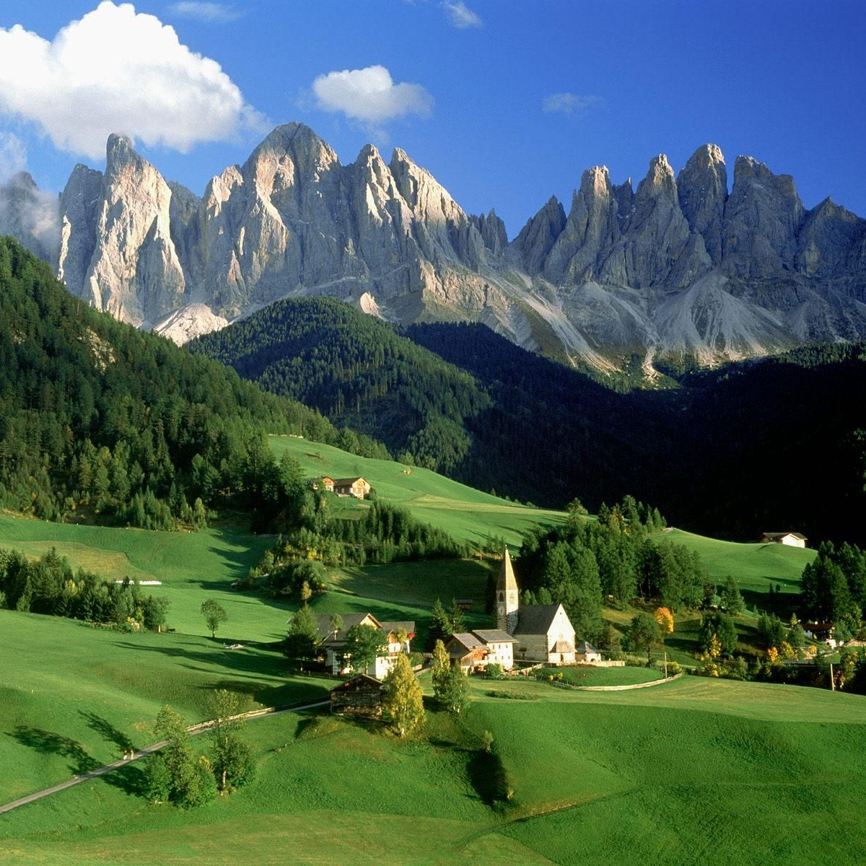
LIFT Analysis with Image Labels
Cities
Beaches
People
Mountains
kirstenalana – 5.33
jtype – 3.63
Thecommonwanderer – 2.09
theslowtraveler – 5.15
Passionpassport – 4.11
Missholldoll – 2.22
Alliemtaylor – 1.87
jess.wandering – 1.47
Kylefrost – 2.09
Reneeroaming – 1.81
Thebucketlistfamily–2.39
Muradosmann – 2.12
Reneeroaming – 2.06
Missholldoll – 2.23
ChelseaKauai – 2.30
Missholldoll – 2.22
Reneeroaming – 1.81
jess.wandering – 1.47
Kylefrost – 2.10
Alliemtaylor – 1.87

Slide 6
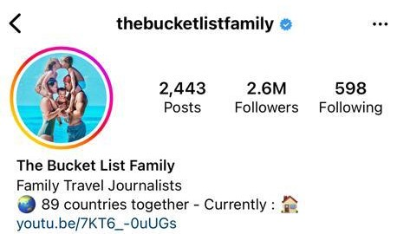
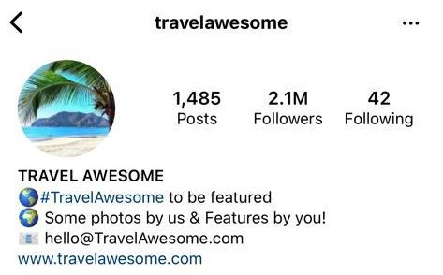
The case of @thebucketlistfamily vs @travelawesome
Analysis of words/Hashtags in captions and image labels which drive high engagement
#like
#time
#followmeto
#love
#little
#feel
#day
Captions
Image
Labels
people
recreation
plant
happy
mountain
photography
flash
leisure
smile
body
sunlight
beach
gesture
highland
head
flower
Influencer | Similarity w/ captions | Similarity w/ image labels | Engagement Score
@thebucketlistfamily | 0.487122 | 0.462239 | 2.370326
@travelawesome | 0.344191 | 0.455944 | 0.699164

Slide 7
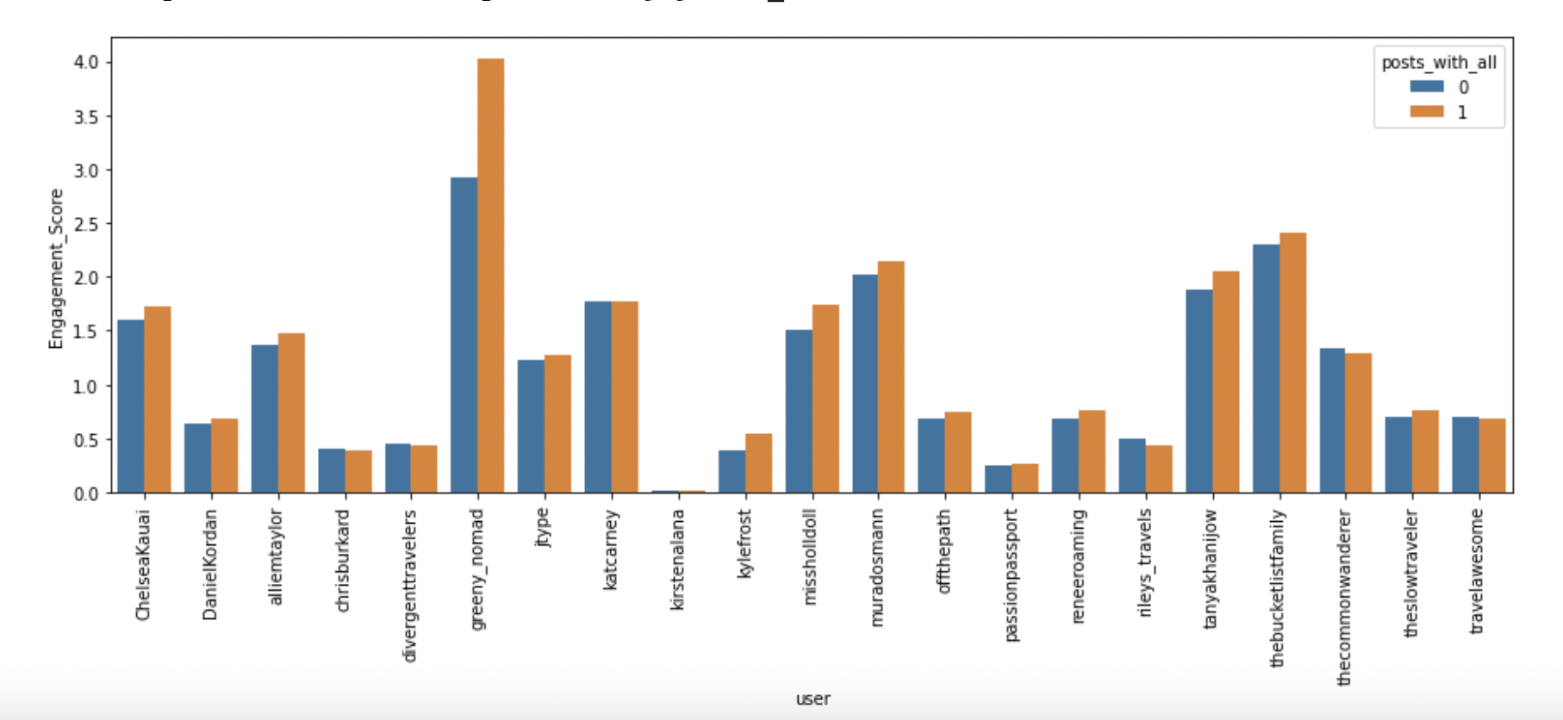
Is it true across all users?
If people or mountain is present in picture, or when captions include subjective feelings/point of view, we can generally expect that engagement will be higher, although in most cases there’s only a slight difference

Slide 8
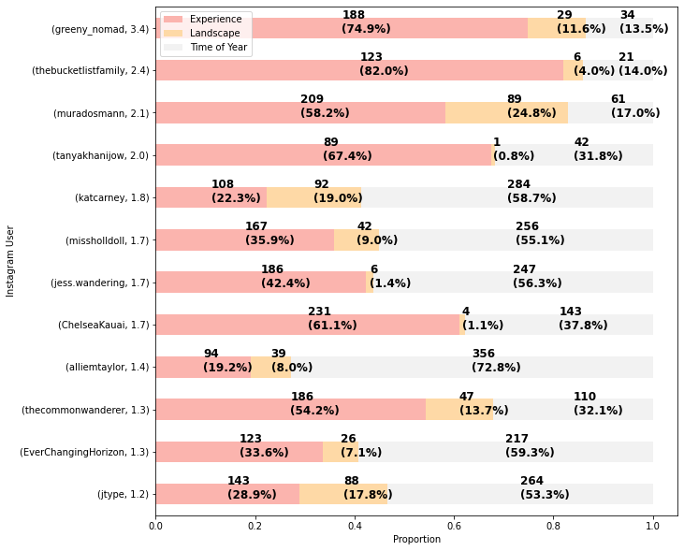
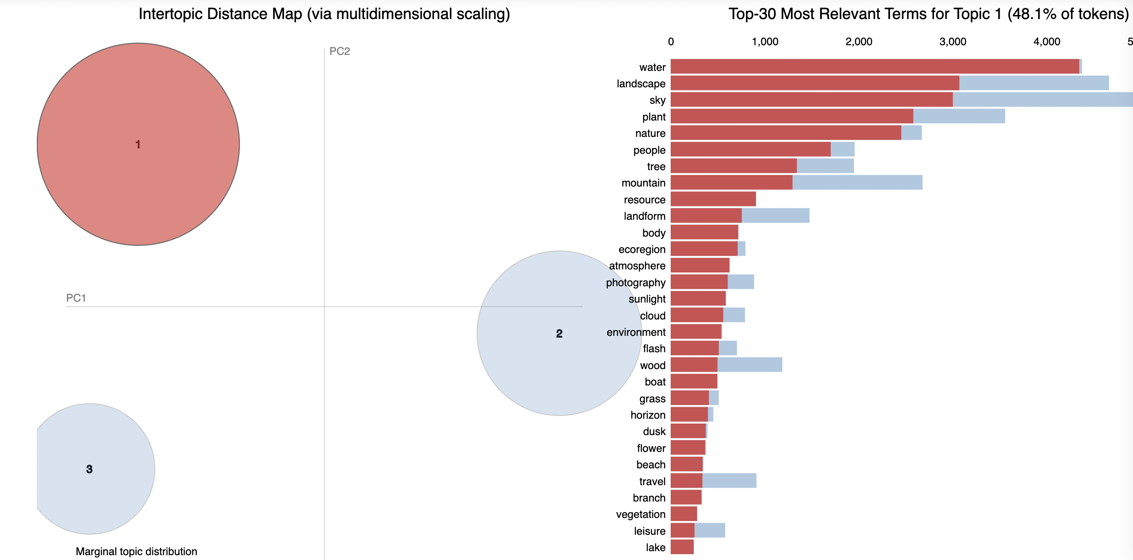
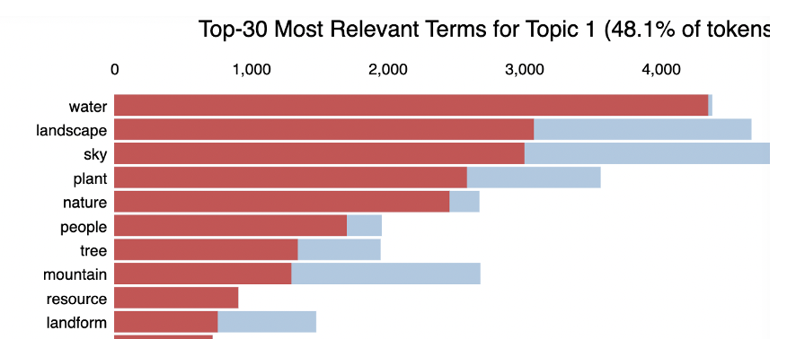
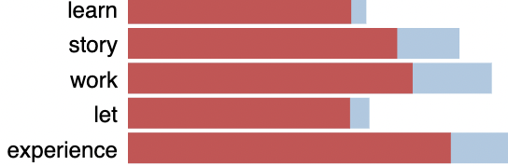
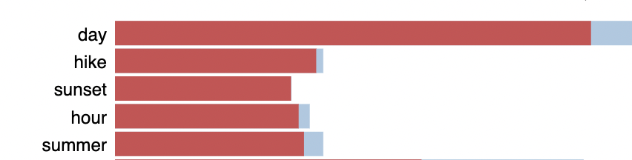
Observations – LDA Topic Modelling
Topic 1
Experience
(Adventure, Moment)
Topic 2- Time - (Fall,
Spring)
Topic 3 - Landscape
Notes:
Amrit

Slide 9
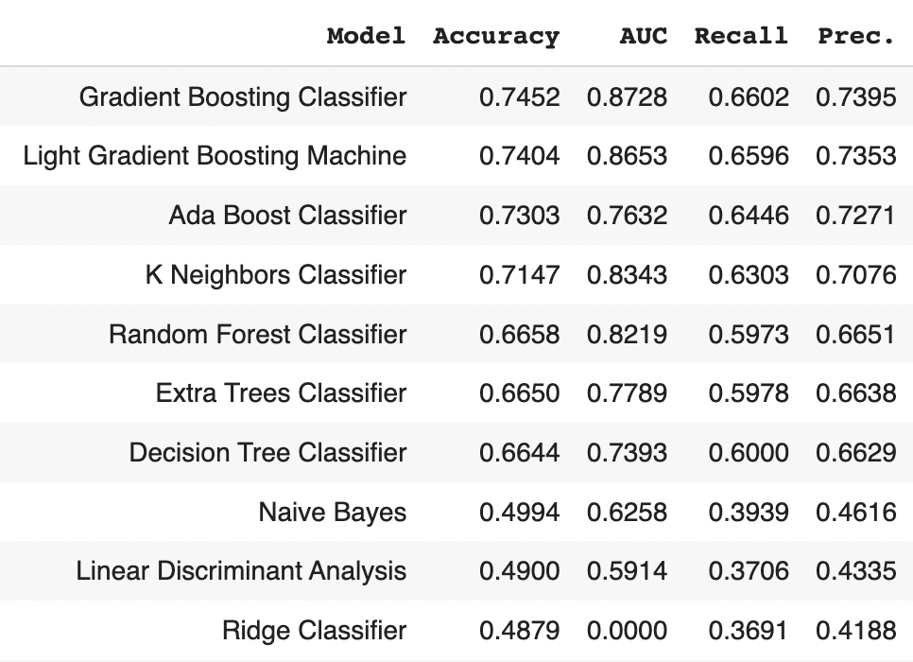
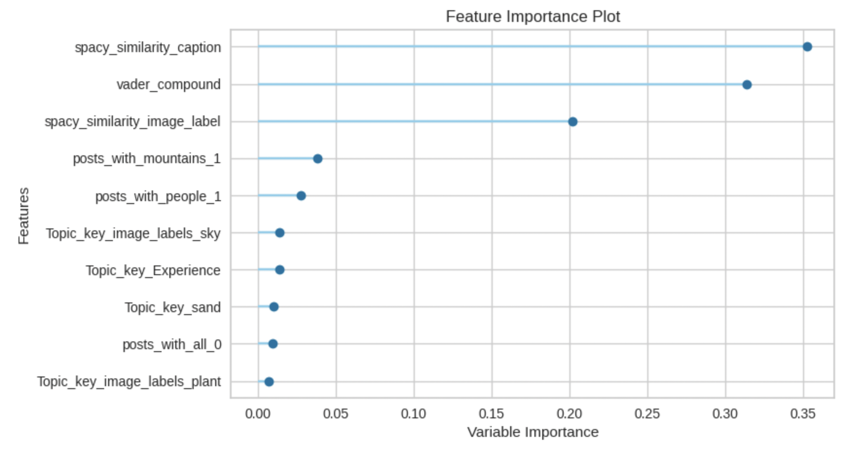
Classification Model – To predict High Instagram Engagement
Model to Predict Engagement Class
Engagement Score = (Number of likes + Number of Comments)/Number of followers
Divided into 3 classes – High, Medium, Low
Notes:
Amrit

Slide 10
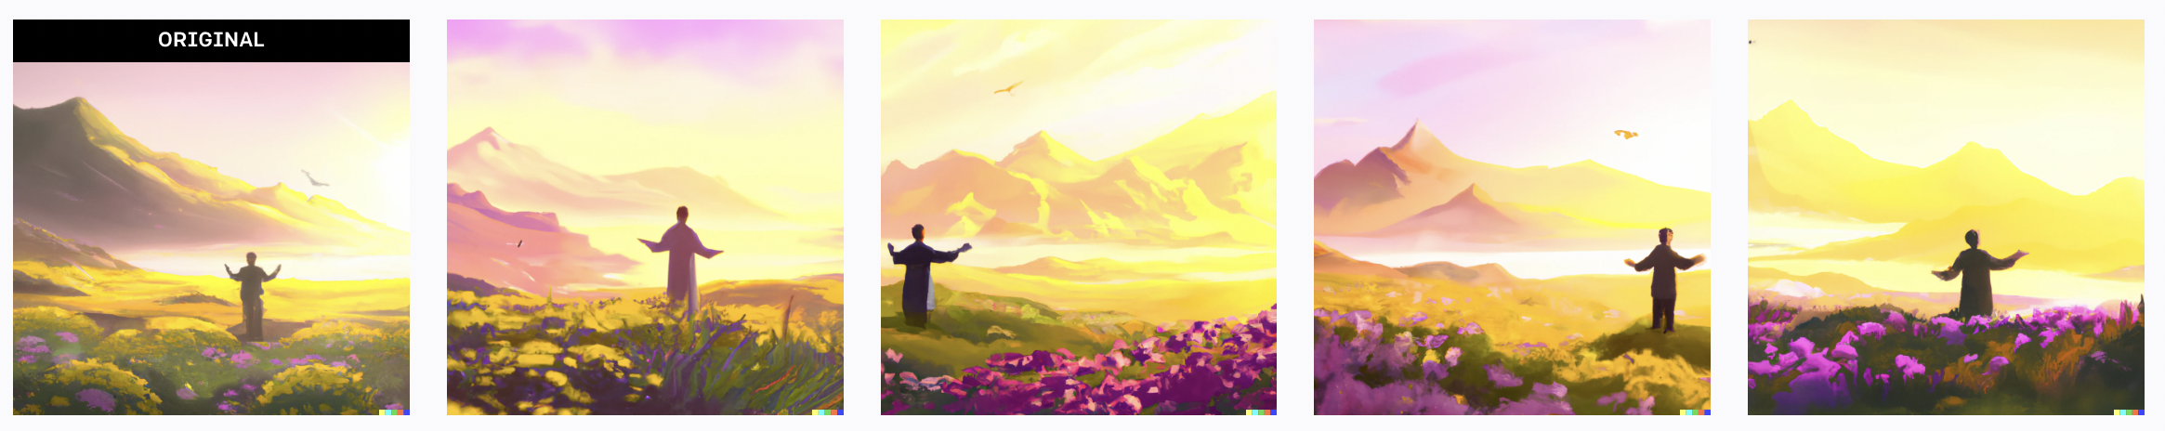
Conclusions – The Instagram Recipe for Travel Content
Images
Mountains
People
happy, photography,flash, leisure, smile, body, face, sunlight, beach, flower
Captions
Experience
Time of Year
Landscape
#like#time#followmeto#love#little#feel#always#us#little #day#today#time
Plant
Images generated using Dalle-2 - Text based image generation and our Image recommendations
Notes:
Anushka

Slide 11
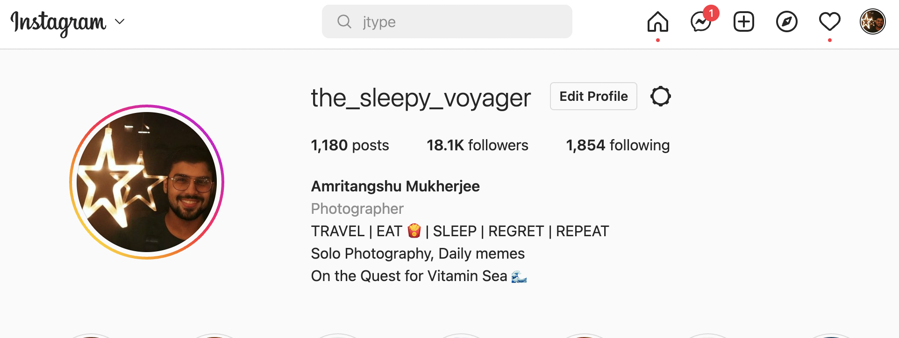
Thank You
Please follow me on Instagram - @the_sleepy_voyager
Notes:
Anushka

